Slide 1
Magic spelling
This activity was developed by Dr. Daniel Jones, CILMAR using the following video:
Stevens, M. [D.O.N.G.]. (2018, June 18). Magic spelling [Video]. YouTube. https://youtu.be/QPLYWyq-VZc

Slide 2
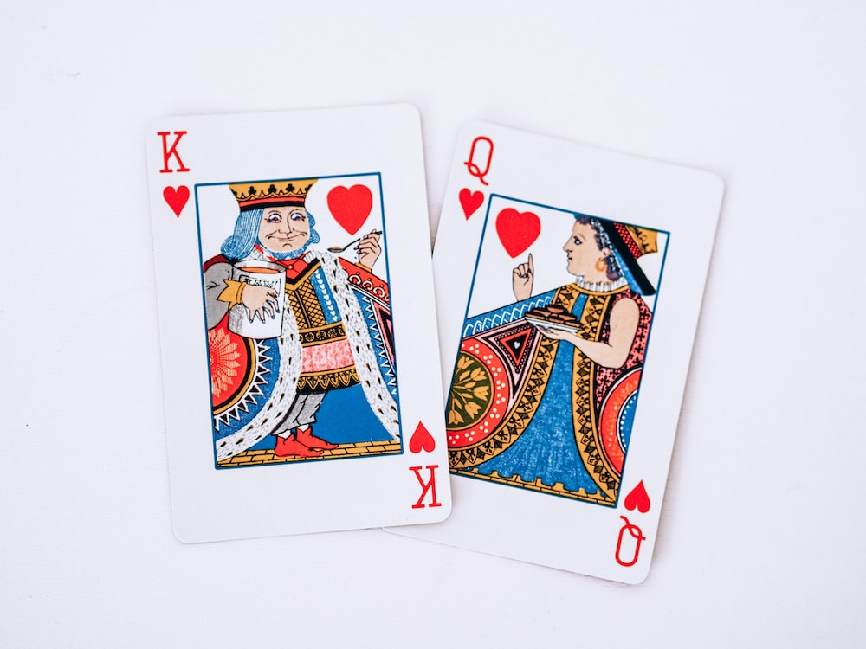
Magic spelling
A curious card trick
9 cards
1 assistant
An abundance of magic and wonder
Pooor, L. (2021, March 7). jack of diamonds playing card. https://unsplash.com/photos/jack-of-diamonds-playing-card-QHutOO4jiRw

Slide 3
Magic spelling
Discussion:
What happened? How did I do it?
Is it magic? Or something else?
Who wants to know how the trick is done?
How might you go about learning this trick?
What if I told you this trick is self-working— a property of numbers and orders?

Slide 4
Magic spelling
The reveal…

Slide 5
Magic spelling
A curious card trick
9 cards
3 stacks of 3
Assistant selects 1 stack
Flip over to reveal THE CARD
Place selected stack on top of the remaining 2 stacks
Spell out the number and suit of THE CARD dealing one card for each letter stopping after each word
Place remaining cards on top
Repeat steps 6 & 7 for each word
After all 3 words are spelled, deal a card for each letter to spell the word MAGIC
Flip over the final card/C to reveal your CARD

Slide 6
Magic spelling
The Debrief:
How did you feel during the activity?
What happened in this activity?
What strategies did you use to solve the problem? Did you ask simple or complex questions?

Slide 7
Magic spelling
The Debrief:
Are there other ways you could get answers? Where could you find the info you need?
What did you learn as a result of this activity? And why does this matter?
How does general curiosity or wonder relate to intercultural curiosity?

Slide 8
Magic spelling
Excerpt from D.O.N.G: Magic Spelling
Notes:
https://www.youtube.com/watch?v=QPLYWyq-VZc&feature=youtu.be

Slide 9
Magic spelling
Intercultural Curiosity
AAC&U Intercultural Knowledge and Competence VALUE Rubric
 | Developing | Emerging | Proficient
Attitude Curiosity | Asks simple or surface questions about other cultures. | Asks deeper questions about other cultures and seeks out answers to these questions. | Asks complex questions about other cultures, seeks out and articulates answers to these questions that reflect multiple cultural perspectives.

